Slide 1
DataShaper
Volume data population based on data shape definition
Open source solution
git://github.com/wanclee/datashaper.git

Slide 2
Data Shape - Challenges
Capture and manage the requirements in one place
Generate large volume of data representing the defined data shape collectively in database tables
Achieve the speed and volume without messy code.

Slide 3
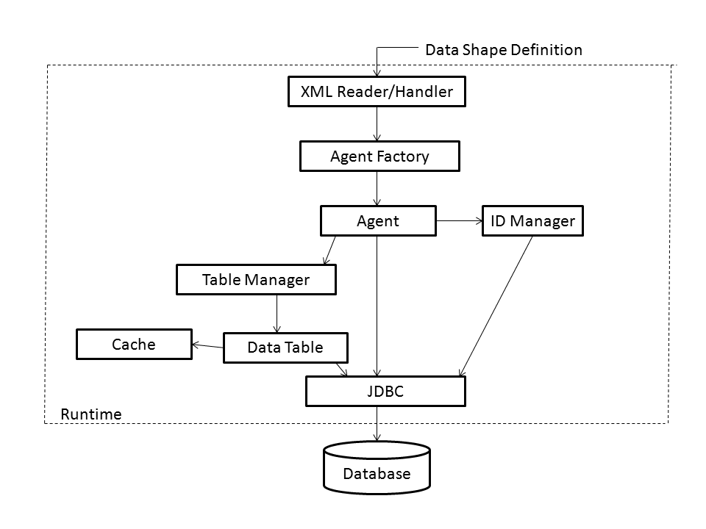
DataShaper Architecture

Slide 4
DataShaper Runtime
(datashaper.jar)
DB agnostic behind JDBC interface. One command-line engine is all the developers need.
Supported DBs: ORACLE, DB2, MYSQL, POSTGRESQL, MSSQLSERVER
Data shape definition expressed as XML configuration

Slide 5
Command Line Execution Example
java
-classpath datashaper.jar:drivers/mysql-connector-java-5.1.13-bin.jar com.psrtoolkit.datashaper.DataShaper
-c samples/mysql/MYSQLExampleSimpleCreateCustomers.xml
-u actproj
-p actproj

